Slide 1
Using Logistic Regression to build a predictive model for Hotel cancellations, we concluded that the most significant factors influencing cancellations are Lead-time, Days in Waiting, Booking Changes, Room Charges, Weeknights Reservations, Duration of Stay, Babies in Reservations, Guest Country, Market Segment, Agent ID, and lastly the Distribution Channel.
Key Insights:
Lead-time: Cancelled bookings have a longer Lead-time than Non-cancelled Bookings, indicating that bookings with a longer lead-time are more likely to get cancelled.
Days in Waiting: Cancelled bookings have a longer average wait-list time (3.6) days than Non-cancelled bookings (1.6) days, indicating that bookings that stay longer on the wait-list are more likely to get cancelled
Booking Changes: Cancelled bookings tend to have a lower percentage in booking changes (9.3%) than non-cancelled bookings (29.3%), indicating that bookings with no to few changes are more likely to get cancelled.
Room Charges: Cancelled bookings tend to have a slightly higher average charge ($104.9) than non-cancelled bookings ($99.9), indicating that cheaper bookings are less likely to get cancelled.
Weeknights Reservations: Cancelled bookings tend to have a slightly higher % of weeknights bookings (73.5) than non-cancelled bookings (72.6%), indicating that Weeknight's bookings are more likely to get cancelled than Weekend bookings.
Duration of Stay: Cancelled bookings have a longer average stay (3.5) days than Non-cancelled bookings (3.4) days, indicating that bookings that long stay bookings are more likely to get cancelled than short stay bookings.
Babies in Reservations: Cancelled bookings tend to lower % of babies in the reservation (0.3%) than non-cancelled bookings (1%), indicating that bookings with babies are less likely to get cancelled.
Guest Country: Portugal have the highest % of Cancellations (56.6%), indicating that Domestic bookings are more likely to get cancelled than International bookings.
Market Segment: Group bookings have the highest % of Cancelled bookings(61%), indicating that Group bookings that are more likely to get cancelled than any other types of bookings.
Agent ID: Agent 1 and Agent 9 have the highest % of Cancelled bookings at (73.4%) and (41.5%) respectively, indicating that bookings by agent 1 or 9 are more likely to get cancelled than bookings by other agents.
Distribution Channel: TA/TO bookings have the highest % of Cancelled bookings (41%), indicating that bookings through TA/TO are more likely to get cancelled than any other types of bookings.

Slide 2
Numerical Variables T-test P-value

Slide 3
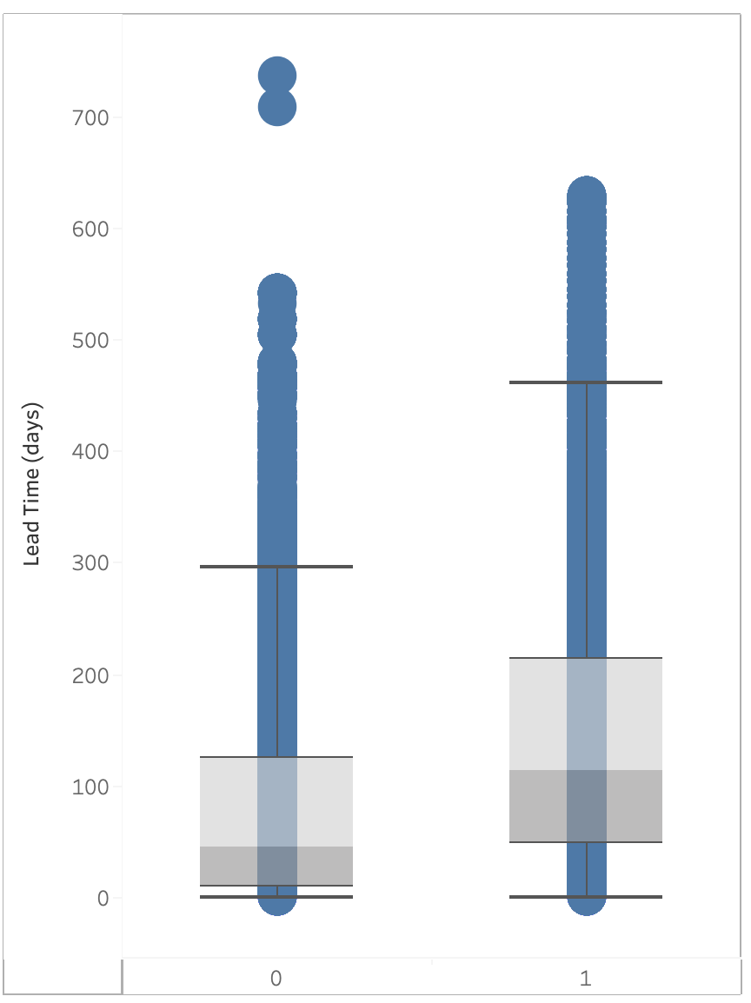
Lead-time
 | 0 (Non-cancelled) | 1 (Cancelled)
Mean | 79.9846872 | 144.848815
Variance | 8301.01166 | 14071.85
Observations | 75166 | 44224
Pooled Variance | 10438.6116
Hypothesized Mean Difference | 0
df | 119388
t Stat | -105.93488
P(T<=t) one-tail | 0
t Critical one-tail | 1.64486639
P(T<=t) two-tail | 0
t Critical two-tail | 1.95998386
T Stat is > t critical at -105.9 and p-value is < 0.05 indicating significance of lead-time in predicting cancellations.
Lead-time for Cancelled bookings is longer than Non-cancelled Bookings, indicating that bookings with a longer lead-time are more likely to get cancelled.

Slide 4
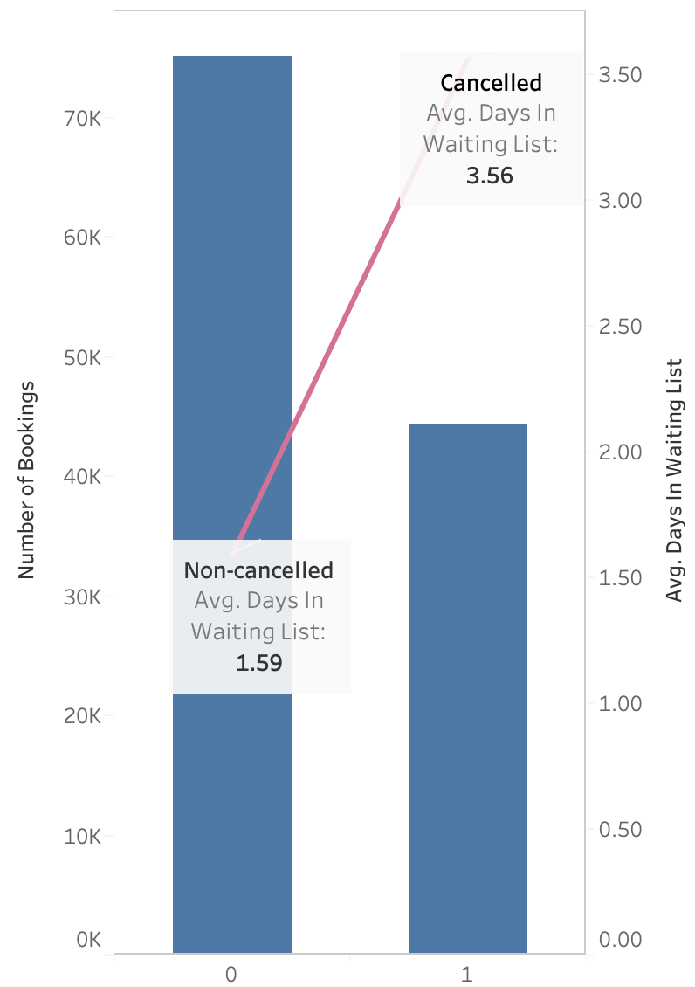
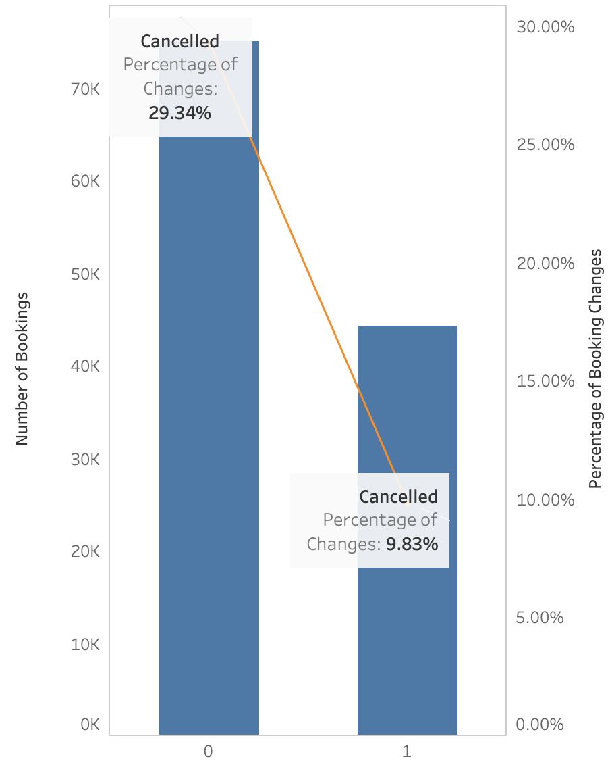
Days in Waiting
T Stat is -18.8 and p-value is < 0.05 indicating significance of Days in Waiting list in predicting cancellations.
Average wait-list time for cancelled bookings (3.6) days longer than Non-cancelled bookings (1.6) days, indicating that bookings that stay longer on the wait-list are more likely to get cancelled
Booking Changes
T Stat is 50.4 and p-value is < 0.05 indicating significance of Booking Changes in predicting cancellations.
Percentage of booking changes for Cancelled bookings (9.3%) is lower than non-cancelled bookings (29.3%), indicating that bookings with no to few changes are more likely to get cancelled.

Slide 5
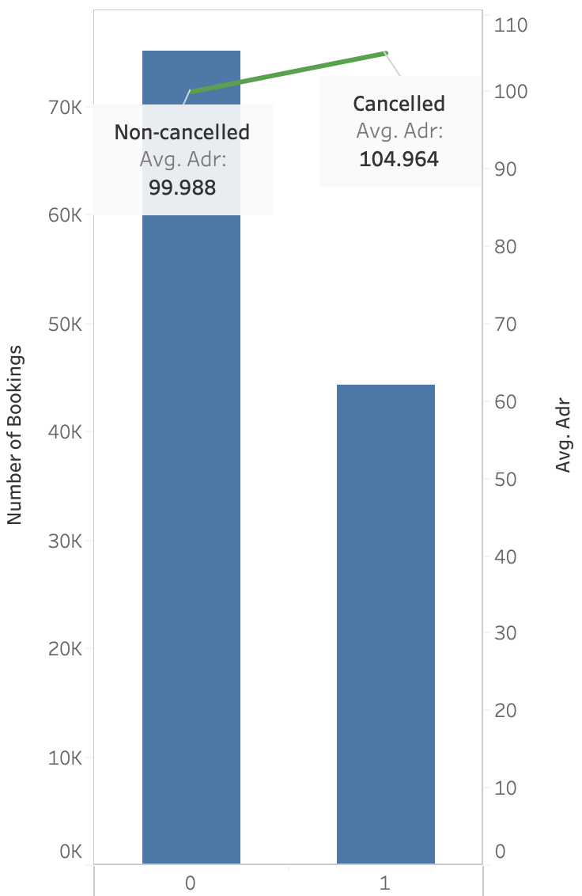
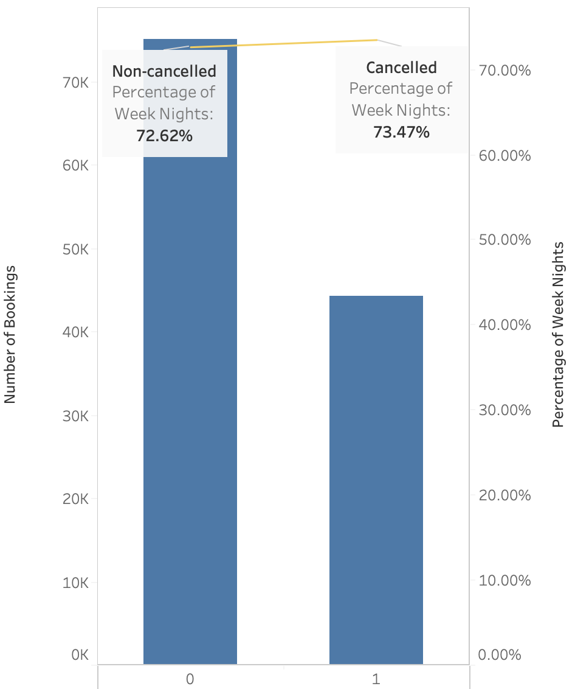
Room Charges
T Stat is -16.5 and p-value is < 0.05 indicating significance of Booking Changes in predicting cancellations.
Average room charges for Cancelled bookings ($104.9) is slightly higher than non-cancelled bookings ($99.9), indicating that cheaper bookings are less likely to get cancelled.
Weeknights Reservations
T Stat is -8.6 and p-value is < 0.05 indicating significance of Booking Changes in predicting cancellations.
Percentage of weeknights bookings for Cancelled bookings (73.5%) is slightly higher than non-cancelled bookings (72.6%), indicating that Weeknight's bookings are more likely to get cancelled than Weekend bookings.

Slide 6
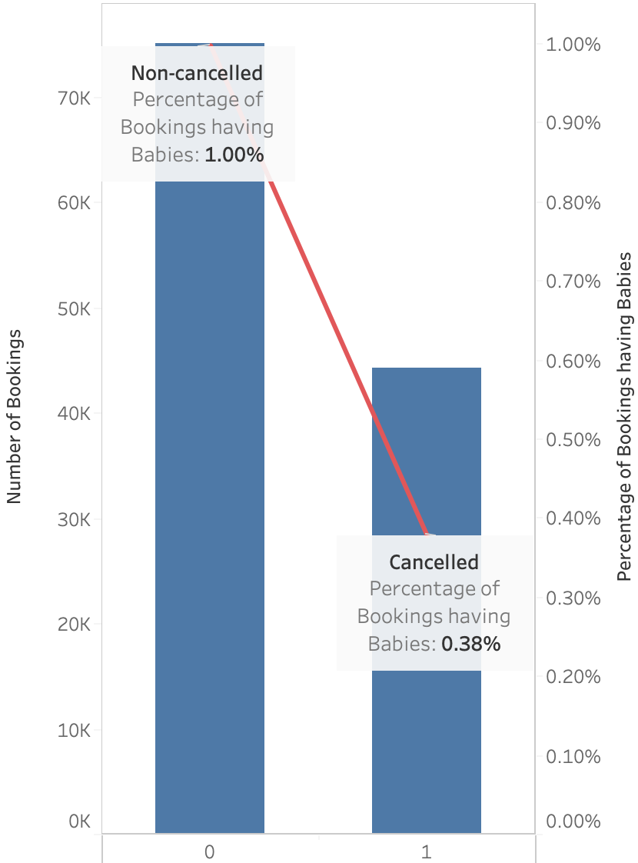
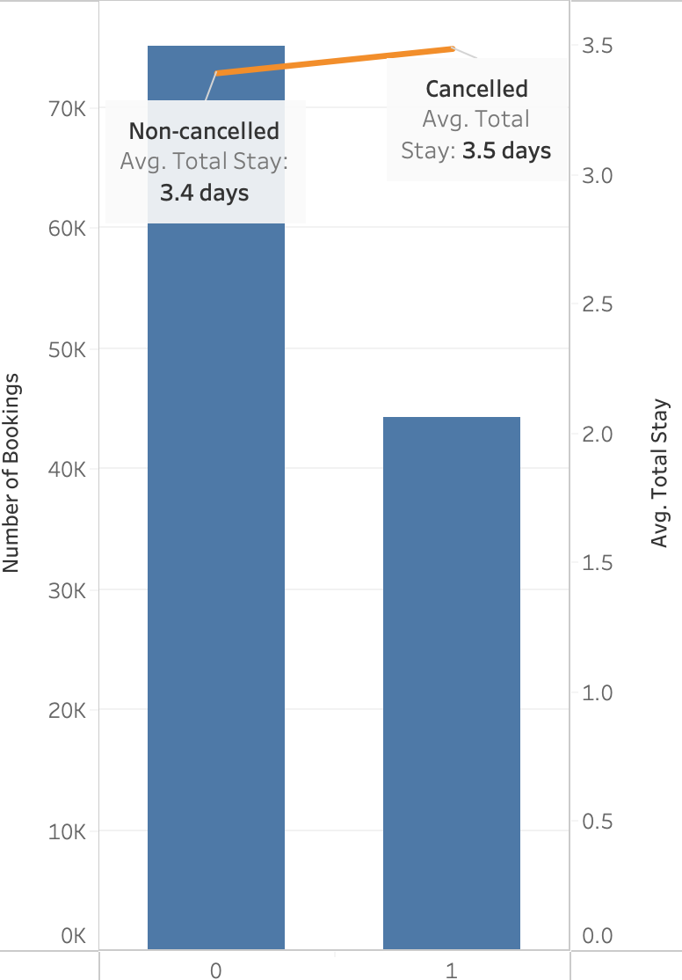
Babies in Reservations
T Stat is 11.2 and p-value is < 0.05 indicating significance of Booking Changes in predicting cancellations.
Percentage of bookings having babies for Cancelled bookings (0.3%) lower than non-cancelled bookings (1%), indicating that bookings with babies are less likely to get cancelled
Duration of Stay
T Stat is -8.6 and p-value is < 0.05 indicating significance of Booking Changes in predicting cancellations.
Average total stay for Cancelled bookings (3.5) days is slightly higher than non-cancelled bookings (3.4), indicating that long stay bookings are more likely to get cancelled than short stay bookings.

Slide 7
Categorical Variables Information Value

Slide 8
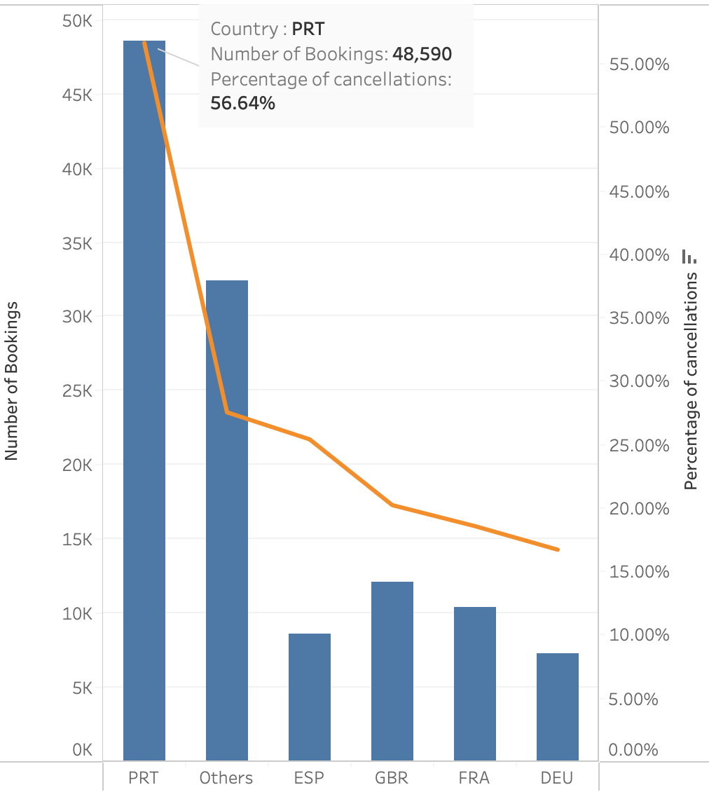
Guest Country
Guest Country | Information Value
DEU | 0.06
ESP | 0.02
FRA | 0.07
GBR | 0.06
Others | 0.05
PRT | 0.27
DEU | 0.06
Total IV | 0.52
Output | Strong Predictor
Guest Country has an IV of 0.5 indicating that it could be a strong predictor for cancellations.
Portugal have the highest % of Cancellations (56.6%), indicating that Domestic bookings are more likely to get cancelled than International bookings.

Slide 9
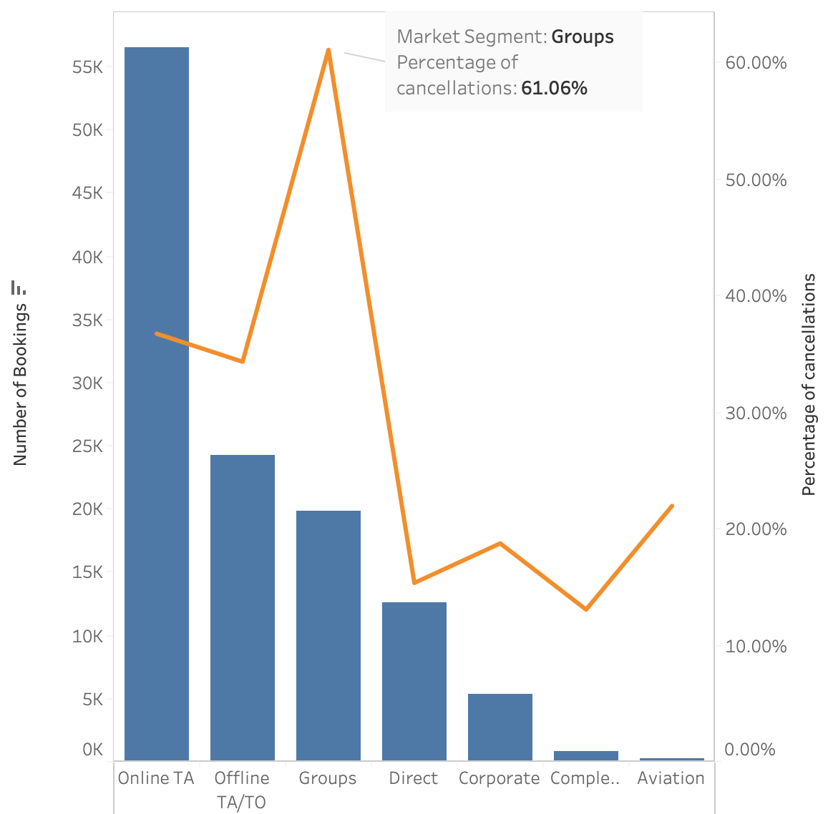
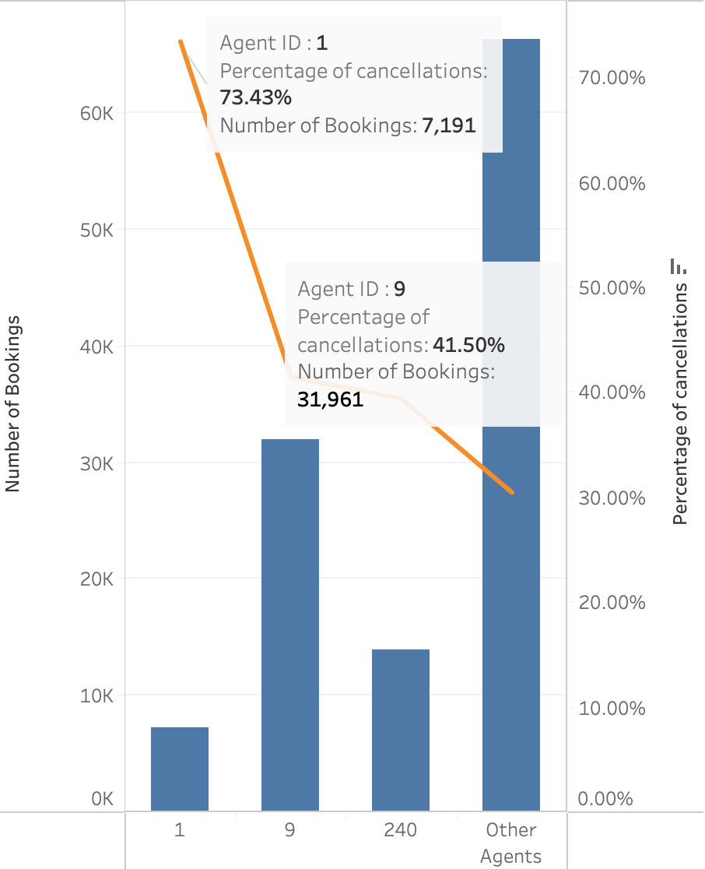
Market Segment
Market Segment has an information value of 0.3 indicating that it could be a strong predictor for cancellations.
Group bookings have the highest % of Cancelled bookings(61%), indicating that Group bookings that are more likely to get cancelled than any other types of bookings.
Agent ID
Agent ID has an IV of 0.2 indicating that it could be a medium predictor for cancellations.
Agent 1 and Agent 9 have the highest % of Cancelled bookings at 73.4% and 41.5% respectively, indicating that bookings by agent 1 or 9 are more likely to get cancelled than bookings by other agents.
It’s imperative to mention than Agent 1 had 7,191 bookings while agent 9 had 31,961 total bookings.

Slide 10
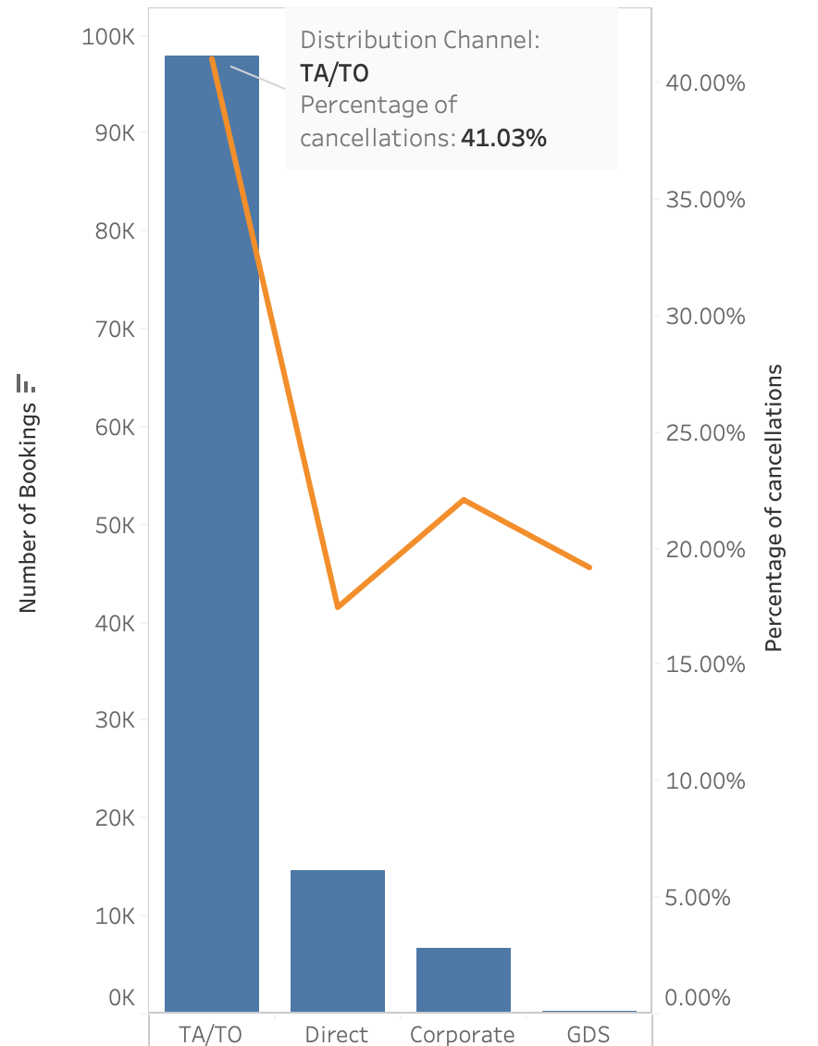
Distribution Channel
Distribution Channel has an IV of 0.16 indicating that it could be a medium predictor for cancellations.
TA/TO bookings have the highest % of Cancelled bookings (41%), indicating that bookings through TA/TO are more likely to get cancelled than any other types of bookings.

Slide 11
Logistic Regression
 |  | Predicted | Predicted
 |  | 0 | 1 | Total
Actual | 0 | 58751 | 16415 | 75166
Actual | 1 | 13139 | 31085 | 44224
 | Total | 71890 | 47500 | 119390
Accuracy | 75.2%
Precision | 65.4%
Recall | 70.3%
TP Rate | 0.7029
FP Rate | 0.22
Cut-off | Accuracy | Precision | Recall
 | 75.2% | 65.4% | 70.3%
0 | 0.37041628 | 0.37041628 | 1
0.1 | 0.53346176 | 0.44134364 | 0.97625724
0.2 | 0.64198007 | 0.50917477 | 0.92863603
0.3 | 0.72370383 | 0.59003285 | 0.83260221
0.4 | 0.75245833 | 0.65442105 | 0.70289888
0.5 | 0.75326242 | 0.70540285 | 0.57333122
0.6 | 0.73951755 | 0.74966711 | 0.44557254
0.7 | 0.71542005 | 0.77733276 | 0.32475579
0.8 | 0.6923863 | 0.85636882 | 0.20371292
0.9 | 0.66485468 | 0.95056709 | 0.1004432

Slide 12
Value of Predictive Model
Decile | Baseline | Total Count | Cancellations | Model
1 | 10% | 11939 | 10029 | 23%
2 | 20% | 11939 | 7954 | 41%
3 | 30% | 11939 | 7307 | 57%
4 | 40% | 11939 | 5917 | 71%
5 | 50% | 11939 | 4772 | 81%
6 | 60% | 11939 | 3283 | 89%
7 | 70% | 11939 | 2284 | 94%
8 | 80% | 11939 | 1428 | 97%
9 | 90% | 11939 | 680 | 99%
10 | 100% | 11939 | 570 | 100%
If the reservations team had the budget and bandwidth to follow-up with 50% of reservations, they would be able to recall 50% of cancellations while our model would be able to recall 81% of cancellations.

Slide 13
Appendix
Cut-off | FP | TP
 | 0.2184 | 0.70
0 | 1 | 1
0.1 | 0.72705745 | 0.97625724
0.2 | 0.52667429 | 0.92863603
0.3 | 0.34036666 | 0.83260221
0.4 | 0.21838331 | 0.70289888
0.5 | 0.14087486 | 0.57333122
0.6 | 0.08753958 | 0.44557254
0.7 | 0.05473219 | 0.32475579
0.8 | 0.02010217 | 0.20371292
1 | 0 | 0

